Slide 1
TMA 1271: Introduction to Machine Architecture
Week 5 and Week 6
(Lecture 1 of 2)
Computer Arithmetic- Part I

Slide 2
WHAT YOU ARE GOING TO STUDY?
How ALU is interconnected with the rest of the processor?
Representation of integers - sign-magnitude, ones complement, twos complement, biased
Sign magnitude rep. - rep., drawbacks
2’s complement rep.- characteristics, examples, geometric depiction,adv.,special cases, use of value-box for conversion, sign extension
Arithmetic with 2’s complement numbers-Addition/Subtraction/Multiplication/Division

Slide 3
ARITMETIC AND LOGIC UNIT(1)….
  Computer do not store numbers or letters
  Computers store bit sequences
  The bit sequences can be interpreted as representing integers or floating point numbers
  Arithmetic is accomplished by the direct hardware implementation of the arithmetic algorithms.

Slide 4
ARITMETIC AND LOGIC UNIT(2)
Does the calculations
Everything else in the computer is there to service this unit
Handles integers
May handle floating point (real) numbers
May be separate Floating Point Unit (maths co-processor)

Slide 5
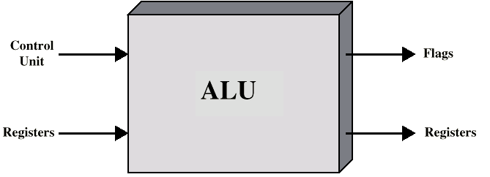
ALU Inputs and Outputs

Slide 6
Integer Representation
Only have 0 & 1 to represent everything
8 bits word could be used to represent the non-negative numbers from 0 to 255.
Positive numbers stored in binary
  e.g. 41=00101001
No minus sign and No period (radix point) for computer storage and processing
General - n-bit sequence: a_{n-1} a_{n-2} …..a₁a₀ is interpreted as unsigned integer A, then
_{n-1}
A = Σ 2^{i} a_{i}
^{i=0}
Representation of negative integers - Sign-Magnitude, one’s complement, Two’s complement, Biased

Slide 7
Sign-Magnitude
Left most bit is sign bit
0 means positive
1 means negative
+24 = 00011000
-24 = 10011000 _{n-2}
A = Σ 2^{i} a_{i ,} if a_{n-1} =0
^{i=0}
General case A = _{n-2}
A = - Σ 2^{i} a_{i ,} if a_{n-1} = 1
^{i=0}
The rule for forming the negation of an integer is invert the sign bit.
{

Slide 8
Conversion Between different bit lengths
For taking n-bit integer and store in m bits, m>n
For sign-magnitude,move the sign bit to the new left-most position and fill in with zeros.
+18 = 0001 0010 (sign magnitude,8bits)
+18=0000 0000 0001 0010 (16 bits)
-18= 1001 0010 (8 bits)
-18=1000 0000 0001 0010 (16 bits)

Slide 9
Reasons for rarely using Sign Magnitude Rep. For implementing the integer portion of ALU-Drawbacks
  While performing addition/subtraction of numbers in sign-magnitude representation, first we have to compare the sign of two operands and if the sign are different, then we have to compare the magnitudes of the operands and then perform the subtraction of smaller magnitude number from the larger magnitude number and we have to put the sign of larger magnitude number as the resultant sign. --- This means the requirement of additional hardware circuitry needed to compare the sign as well as magnitude.Time taken for performing addition/subtraction will also be more. Example: (+60) – (-1234), (+1234) – (-60)
  Two representations of zero (+0 and -0)- difficult to test for zero-always should convert from -0 to +0 .

Slide 10
Twos Complement
The two’s complement representation was developed to overcome the two principal drawbacks of the sign-magnitude representation:
  A) addition and
  B) subtraction

Slide 11
Twos Complement
+3 = 00000011
+2 = 00000010
+1 = 00000001
+0 = 00000000
-1 = 11111111
-2 = 11111110
-3 = 11111101

Slide 12
Benefits
One representation of zero
Arithmetic works easily (see later)
Negating is fairly easy
  + 3 = 00000011 (twos complement)
  Bitwise complement = 11111100
  Add 1 to LSB + 1
  11111101 = - 3

Slide 13
Twos Compliment - characteristics (1)….
Range : -2^{n-1} to 2^{n-1} -1
8 bit 2s compliment
  +127 = 01111111 = 2⁷ -1
  -128 = 10000000 = -2⁷
16 bit 2s compliment
  +32767 = 011111111 11111111 = 2¹⁵ - 1
  -32768 = 100000000 00000000 = -2¹⁵
Number of representations of zero : One (No negative zero).

Slide 14
Twos Compliment - characteristics (2a)….
Negation (conversion from positive to negative and vice versa )
Process 1: Take the Boolean complement of each bit if the integer (including the sign bit). That is, set the each 1 to 0 and each 0 to 1
Process 2: Treating the result as an unsigned binary integer , add 1

Slide 15
Twos Compliment - characteristics (2b)….
The two-step process is referred to as the twos complement operation, or taking of the twos complement of an integer
Negation - example
+18
=
00010010
(two complement)
Bitwise complement
=
11101101
+ 1
11101110
= -18
The negative of the negative of that number is itself : ( -(-18) = 18
-18
=
11101110
(two complement)
Bitwise complement
=
00010001
+ 1
00010010
= +18

Slide 16
Twos Compliment - characteristics (3)
Expansion of Bit length: Add additional bit positions to the left and fill in with the value of the original sign bit (refer to slide 24)
Overflow Rule: If two numbers with the same sign are added, then overflow occurs if and only if the result has the opposite sign. (refer to slide 26)
Subtraction Rule: To subtract B from A, take the two’s complement of B and add it to A.(refer to slide 28)

Slide 17
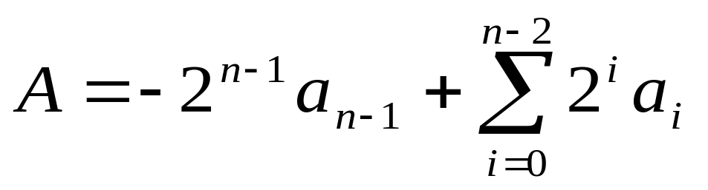
Expression for 2s complement representation
Range of positive integers represented = 0 (all the magnitude bits are 0’s) through 2^{n-1} -1 ( all the magnitude bits are 1’s) - Ex: for 8 bit, 00000000 (0) through 01111111(127 2⁷-1)
Range of negative numbers represented = -1 (11111111 (for 8bit)) through - 2^{n-1} (10000000)
Equation defining the two’s complement representation for both positive and negative numbers

Slide 18
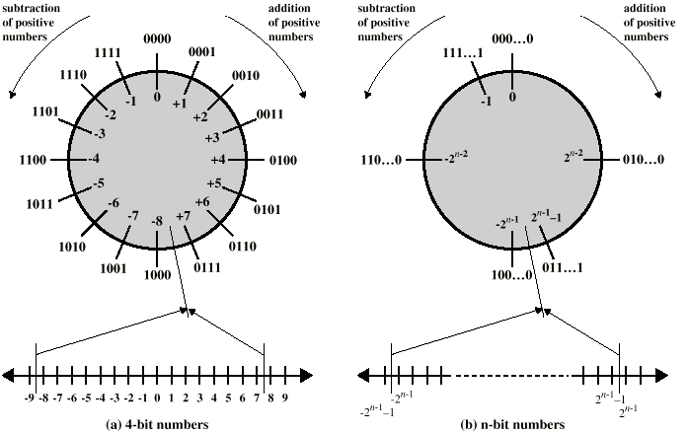
Geometric Depiction of Twos Complement Integers

Slide 19
Advantages-Reasons for using 2s complement rep. For the integer portion of ALU
One representation of zero
Arithmetic works easily - No special hardware required
Negating is fairly easy
  3 = 00000011
  Boolean complement gives 11111100
  Add 1 to LSB 11111101
  else
  starting from LSB, write the bits as it is up to and including the first 1, find 1’s comp. of remaining bits

Slide 20
Negation Special Case 1
0 = 00000000
Bitwise complement 11111111
Add 1 to LSB +1
Result 1 00000000
carry out of MSB is ignored, so:
- 0 = 0

Slide 21
Negation Special Case 2 (1)…..
-128 = 10000000
bitwise complement 01111111
Add 1 to LSB +1
Result 10000000
So:
-(-128) = -128 X
Monitor MSB (sign bit)
It should change during negation

Slide 22
Negation special case -2 -discussion(2)
Number of different bit patterns in an n-bit word is 2^{n --} even number
wish to represent positive, negative integers and zero
equal number of positive and negative representation of integers - two representations for zero (Sign Magnitude )
one representation of zero, unequal number of positive and negative integers (2’s comp. - rep. For - 2^{n-1} but not for + 2^{n-1}
^{Range =} - 2^{n-1 through} 2^{n-1} -1 (example: 4 bit , -8 through +7)

Slide 23
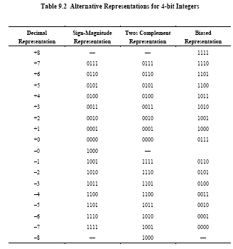

Slide 24
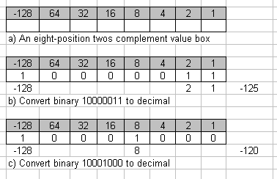
Use of a Value Box for Conversion between twos Complement Binary and Decimal

Slide 25
Conversion Between different bit lengths
For 2’s complement,
Positive number pack with leading zeros
+18 = 00010010 (8 bits)
+18 = 00000000 00010010 (16 bits)
Negative numbers pack with leading ones
-18 = 11101110 (8 bits)
-18 = 11111111 11101110 (16 bits)
i.e. pack with MSB (sign bit)
called sign extension

Slide 26
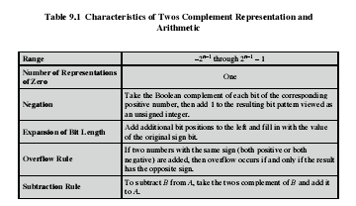
Twos Compliment – characteristics summary

Slide 27
FIXED POINT REPRESENTATION
Called so since the binary point is fixed and assumed to be the right of the right-most digit
can use the same representation for fractions by scaling the numbers

Slide 28
CONDITION FOR OVERFLOW
  If two numbers are added, and they are both positive or both negative, then overflow occurs if and only if the results has the opposite sign.
  Note that overflow can occur whether there is a carry or not

Slide 29
DETECTION OF OVERFLOW
Carry out of sign bit and carry into the sign bit will be given as two inputs to the exclusive-OR gate and the output of exclusive-OR gate is connected to overflow flip-flop.
If carry out of sign bit and carry into sign bit are equal - NO overflow
If carry out of sign bit and carry into sign bit are not equal - OVERFLOW occurs

Slide 30
Addition and Subtraction
Normal binary addition
Monitor sign bit for overflow
Take twos compliment of subtrahend and add to minuend
  i.e. a - b = a + (-b)
So we only need addition and complement circuits

Slide 31
Addition of Numbers in Twos Complement Representation
(-7) + (+5)
1001
+0101
1110 = -2
(-4) + (+4)
1100
+0100
1 0000 = 0
(+3) + (+4)
0011
+0100
0111 = 7
(-4) + (-1)
1100
+1111
1 1011 = -5
(+5) + (+4)
0101
+0100
1001 = overflow
(-7) + (-6)
1001
+1010
1 0011 =overflow

Slide 32
Subtraction of Numbers in Twos Complement Representation (M-S)
    To subtract one number (subtrahend) from another (minuend), take the two’s complement of the subtrahend and add it to the minuend.
    Thus, subtraction is achieved using addition, as illustrated in the figure below. The last two examples demonstrate that the overflow rule still applies

Slide 33
Subtraction of Numbers in Twos Complement Representation (M-S) (minuend – subtrahend)
0010
+1001
1011 = -5 (negate 1011)
M = 2 = 0010
S = 7 = 0111
-S = 1001
0101
+1110
1 0011 = 3
M = 5 = 0101
S = 2 = 0010
-S = 1110
Carry will be discarded
1011
+1110
1 1001 = -7 ( negate 1001)
M = -5 = 1011
S = 2 = 0010
-S = 1110
0101
+0010
0111 = 7
M = 5 = 0101
S = -2 = 1110
-S = 0010
Carry will be discarded
0111
+0111
1110 = overflow
M = 7 = 0111
S = -7 = 1001
-S = 0111
1010
+1100
1 0110 = overflow
M = -6 = 1010
S = 4 = 0100
-S = 1100

Slide 34
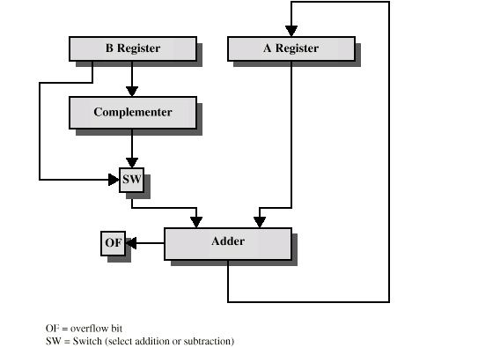
Hardware for Addition and Subtraction

Slide 35
Multiplication
Multiplication is a complex operation, whether performed in hardware or software
We begin with the simpler problem of multiplying two unsigned (nonnegative) integers, and then we look at one of the most common techniques for multiplication of numbers in twos complement representation.
The multiplication of two n-bit binary integers results in a product of up to 2n bit length. Example: 4 bits X 4 bits equal maximum 8 bits length

Slide 36
Multiplication for unsigned binary integers
Example-paper and pencil approach
1011 Multiplicand (= 11 Dec.)
x 1101 Multiplier (= 13 Dec.)
1011 Partial products
0000
1011
1011
10001111 Product (143 dec)
Note: if multiplier bit is 1, copy multiplicand (place value) otherwise zero
Note: need double length result

Slide 37
Multiplication-implementation
To make the operation more efficient, - running addition on the partial products rather than waiting until the end - eliminates the need for storage of all partial products. - For each 1 on the multiplier, add and shift operation
- for each 0, only shift - save time on the generation of partial products

Slide 38
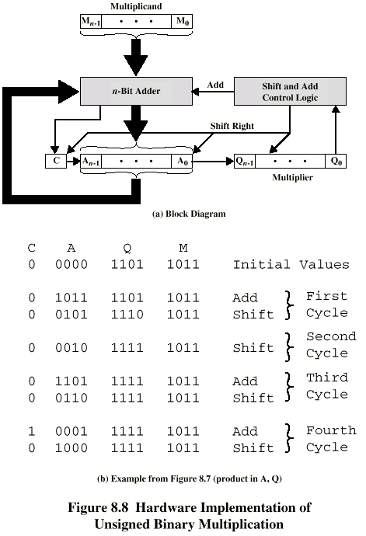
Unsigned Binary Multiplication

Slide 39
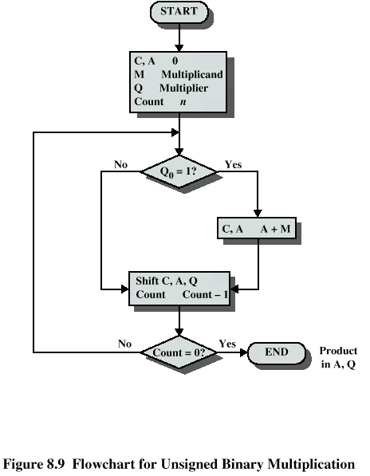
Flowchart for hardware implementation of Unsigned Binary Multiplication
A = register
C = 1 bit register, use to detect overflow

Slide 40
Execution of Example

Slide 41
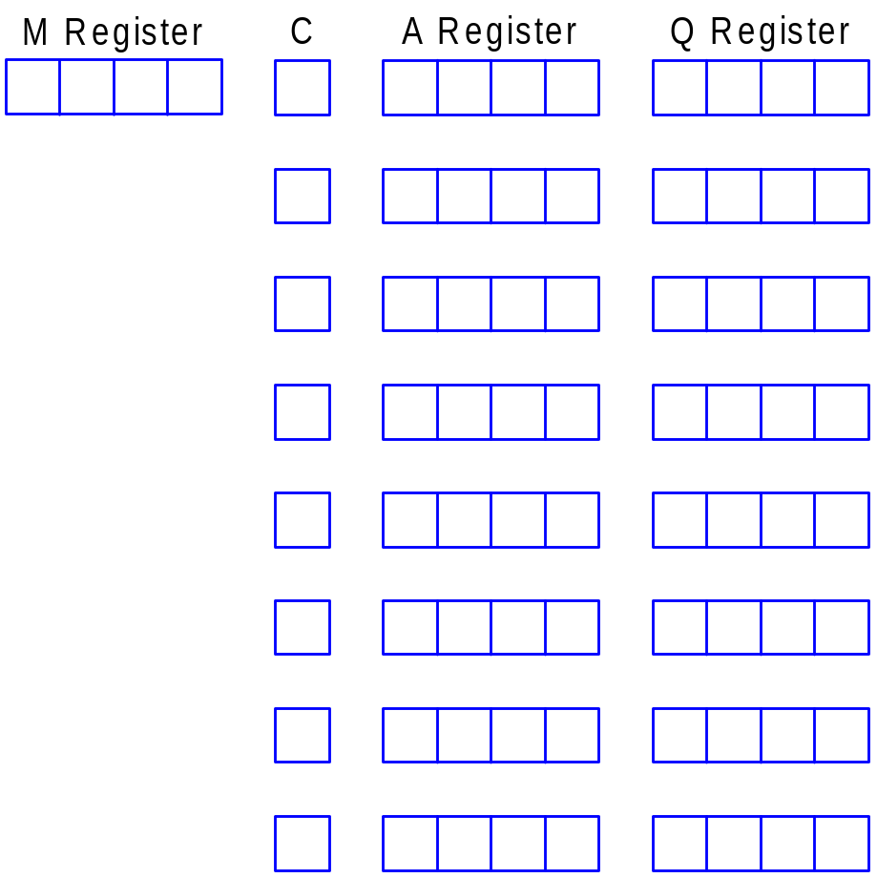


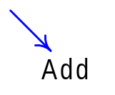

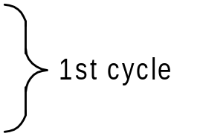



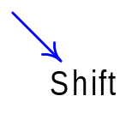



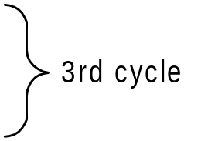


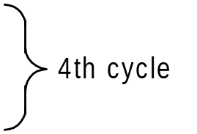

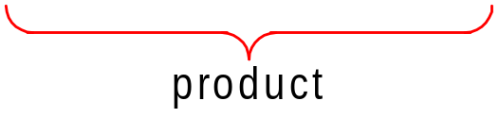
hardware implementation of Unsigned Binary Multiplication example: Consider 0110₂ x 1101₂, where 0110₂ is the multiplicand (M) and 1101₂ is the multiplier (Q)
Slides adapted from twhaw’s lecture notes

Slide 42




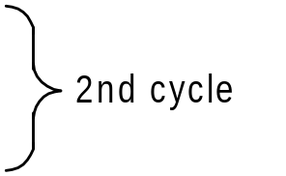





Consider 1100₂ x 1011₂:where 1100₂ is the multiplicand (M) and 1011₂ is the multiplier (Q)

Slide 43
PROBLEM (1)
A. Provide a definition of one’s complement numbers using a weighted sum of bits. B. What is the range of numbers that can be represented in one’s complement? C. Define an algorithm for performing addition in one’s complement arithmetic.

Slide 44
SOLUTION (1)
A. n-2
A = - (2^{n-1} - 1) a_{n-1} + Σ 2^{i} a_{i}
^{i=0}
b. from -(2^{n} - 1) through (2^{n} - 1)
c. 1. Add two numbers as if they were unsigned integers 2. If there is a carry out of the sign position, then add that bit to LSB of the result and propagate the carries as necessary. (end-around carry rule) 3. An overflow occurs if two positive numbers are added and the result is negative or if two negative numbers are added and the result is positive.

Slide 45
PROBLEM(2)
Find the following differences using twos complement arithmetic:
a. 111000 - 110011
b. 11001100 - 101110
c. 111100001111 - 110011110011
d. 11000011 - 11101000

Slide 46
PROBLEM (3)
Is the following a valid alternative definition of overflow in twos complement arithmetic?
If the exclusive-or of the carry bits into and out of the left-most column is 1, then there is an overflow condition. Otherwise there is not.

Slide 47
PROBLEM (4)
What is the range of numbers that can be represented in 8 bit and 16 bit ones complement numbers
Perform addition and subtraction of 8 bit numbers using 1’s complement representation using different examples

Slide 48
Problem (5)
Specify the characteristics of 1’s complement and sign magnitude numbers with respect to a. range b.number of representations of zero c. Negation d. Expansion of bit length e. Overflow Rule f. Subtraction Rule

Slide 49
Problem (6)
Consider the following operation on a binary word. Start with the least significant bit, copy all bits that are 0 until the first bit is reached and copy that bit , too. Then take the complement of each bit thereafter. What is the result?

Slide 50
Problem(7)
Show that the following is the equivalent definition for 2’s complement. For an n-bit integer X, the twos complement of X is formed by treating X as an unsigned integer and calculating (2^{n}-X).

